Slide 1
Secure data Hiding In Image using Stegnography
CAPSTONE PROJECT
Presented By: Nikhil Shivaji Khot
Student Name : Nikhil Shivaji Khot
College Name & Department :SDSM College (Mumbai University), IT Department

Slide 2
OUTLINE
Problem Statement
Technology used
Wow factor
End users
Result
Conclusion
Git-hub Link
Future scope

Slide 3
Problem Statement
Traditional encryption techniques make messages noticeable to attackers. This project embeds secret messages within images using steganography, ensuring secure communication without raising suspicion.

Slide 4
Technology used
Programming Language: Python
Libraries Used: OpenCV (cv2), OS, String
Concepts: Image Processing, ASCII Encoding, Pixel Manipulation
Hardware Used:
Computer/Laptop with Python environment
Secure Storage Device (HDD/SSD) for encrypted image files
RAM (8GB or more) for efficient processing
Processor (Intel i5/AMD Ryzen 5 or higher) for fast computations

Slide 5
Wow factors
Passcode protection ensures only authorized users can decrypt messages.
Provides high security while maintaining image integrity.
Uses pixel values to hide messages securely.
UI Design

Slide 6
End users
Cybersecurity Experts
Journalists & Whistleblowers
Government & Military Organizations
Individuals Seeking Private Communication

Slide 7

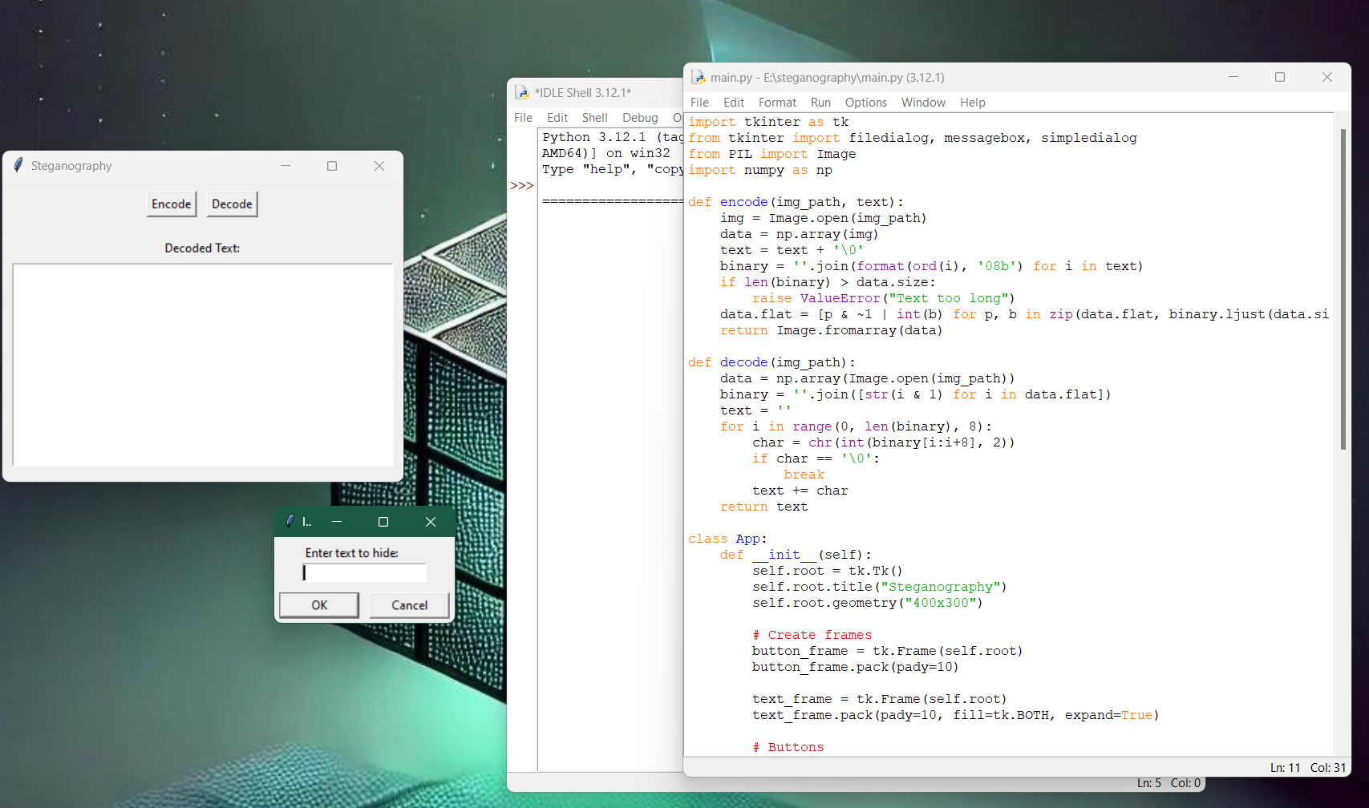

Results

Slide 8
Conclusion
This project demonstrates how image steganography can be used for secure data transmission. By embedding messages within image pixels, sensitive information can be shared covertly, adding an extra layer of security beyond traditional encryption.

Slide 9
GitHub Link
https://github.com/Nikhilkhot02/Edunet_project.git

Slide 10
Future scope
Implementing AES encryption along with steganography for double security.
Developing a GUI-based tool for ease of use.
Extending support to audio & video steganography for enhanced security.

Slide 11
THANK YOU

